Slide 1
Introduction to DBMS
By Kusuma M

Slide 2
What is DBMS?
Database Management System consists of two parts:
Database
Management System
Database: An organized collection of data.
Management System: A set of programs to access or retrieve, update and manipulate the data in the database that is both convenient and efficient.
A DBMS is a software that stores, manages, and retrieves data efficiently. Ex: MySQL, Oracle, MSSQL, PostgreSQL

Slide 3
What is Database?
Data: Collection of information or facts.
Record: Collection of related data items.
Table / Relation: Collection of related records.
Database: Organized collection of related tables or relations.
In simple words, Database is a server which stores the collection of data.
Stores Data
Manages Data
Analyses Data

Slide 4
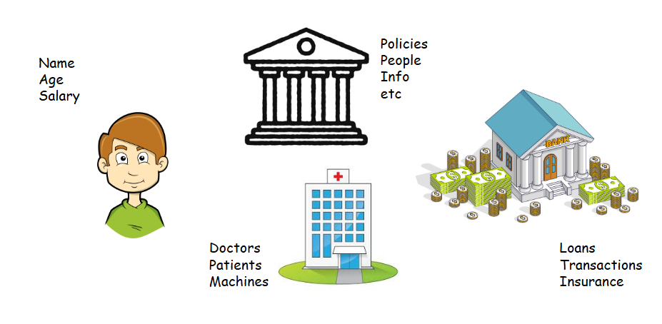
What type of Data stores in a Database?
Data can be anything and everything

Slide 5
File Management System
Storing, organizing, retrieving and managing data files in a computer system.
Limitations of FMS:
Data Redundancy & Inconsistency
Lack of concurrency control
Poor Security
No Relationships between data
Manual backup & recovery
Scalability Issues
which led to creation of DBMS.

Slide 6
Contd.,
Features of DBMS:
Reduces data redundancy
Improves data consistency
Supports multiple users
Enforces security
Provides backup & recovery

Slide 7
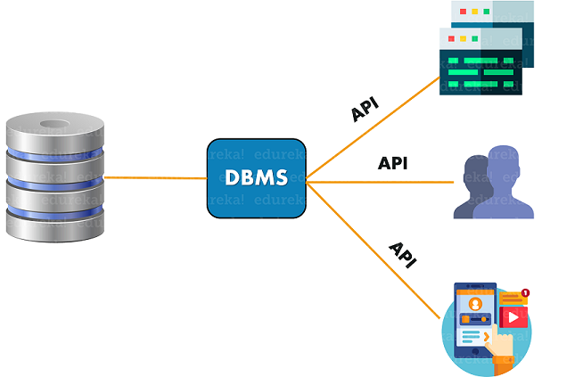
How DBMS works?

Slide 8
Database Models
Databases organize data in different structures called models.
Types of Database Models:
Hierarchical (1970s-1990s):- Tree-like structure; parent-child relationships
Network (1970s-1990s):- Graph like connections between records
Relational (1980s-present):- Tables with rows & columns
Object-Oriented (1990s-present):- Data stored as objects with attributes & methods
NoSQL / Document :- Stores unstructured/semi-structured data

Slide 9
Components of a Database
Data: The actual information stored in the database, such as text, numbers, images, or files.
Schema: The structural blueprint that defines how data is organized tables, fields, data types, and relationships.
DBMS: The software that manages database operations like storage, retrieval, and security (e.g., MySQL, Oracle).
Queries: Instructions (usually SQL) used to retrieve or manipulate data within the database.
Users: People or systems that interact with the database, each with specific roles and access permissions.

Slide 10
Types of Databases
Databases can be classified into two primary types: Relational (SQL) and Non-Relational (No-SQL) Databases.
NoSQL is then furtherly divided into four types:
Document-oriented
Key-Value
Wide-Column
Graph databases

Slide 11
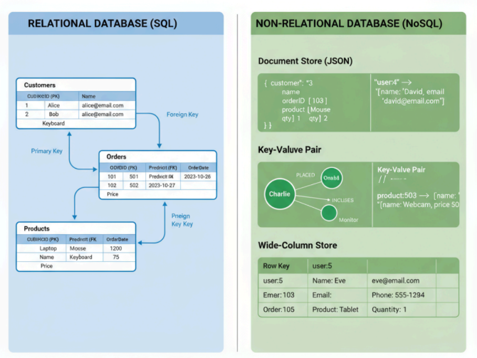

Slide 12
1. Relational Databases (RDBMS)
Organize data into tables made up of rows (records) and columns (fields). They use schemas (blueprints) to define how data is structured and how different tables relate to each other.
Strict schema-based structure.
Primary Keys (unique IDs) and Foreign Keys (relationships between tables).
Strong ACID compliance (Atomicity, Consistency, Isolation, Durability).
Ideal for structured data.

Slide 13
2. NoSQL Databases
"NoSQL" stands for "Not Only SQL". These databases are designed to handle unstructured or semi-structured data, such as text, images, videos or sensor data. They don’t rely on the traditional table format.
Flexible data models (no fixed schema).
Scales horizontally for high-volume data.
Often optimized for specific use cases like graphs or time-series data.

Slide 14
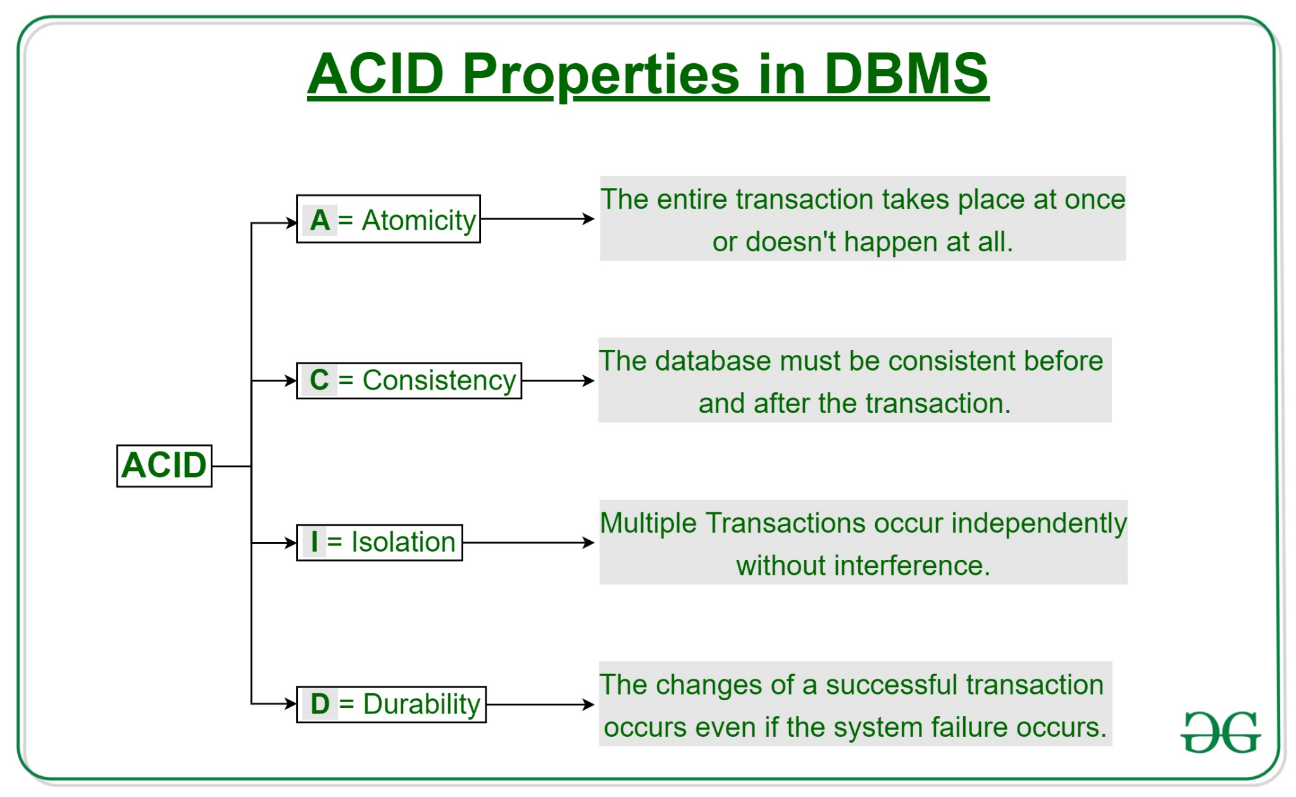
ACID Properties

Slide 15
Database Design Process
Requirement Analysis: Identify what data is needed
Identify Entities: Ex: Student, Course
Identify Relationships: Ex: Enrolled_in
Draw E-R Diagram: Visualize entities & connections
An Entity-Relationship (ER) Diagram is one of the most important tools in database design. It provides a visual blueprint for how data will be stored, connected and accessed.

Slide 16
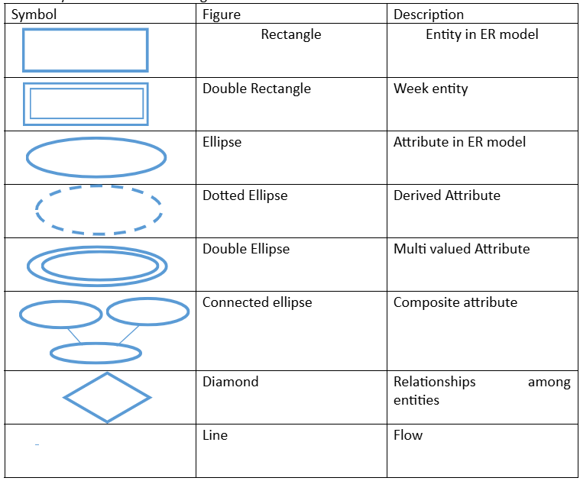

Slide 17
What is MySQL?
MySQL is an open-source relational database management system that works on many platforms. It provides multi-user access to support many storage engines and is backed by Oracle. So, you can buy a commercial license version from Oracle to get premium support services.
MySQL = Relational DBMS (RDBMS)
Stores data in tables (rows & columns)
Uses SQL to interact with data
Open-source, widely used for web apps (Python, PHP, Java)

Slide 18
History of MSQL
Created by Michael Widenius (Monty Widenius) and David Axmark in 1995 at MySQL AB (Sweden).
Initially developed as an open-source alternative to expensive RDBMS products like Oracle and IBM DB2.
Acquired by Sun Microsystems in 2008, then by Oracle Corporation in 2010.
Current stable versions maintain community (open-source) and enterprise (paid) editions.

Slide 19
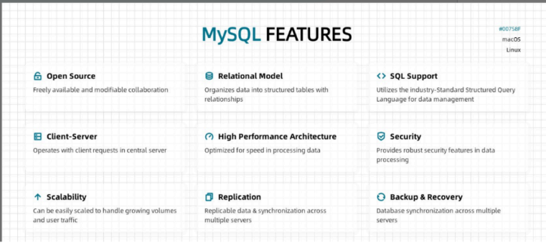
MySQL Features

Slide 20
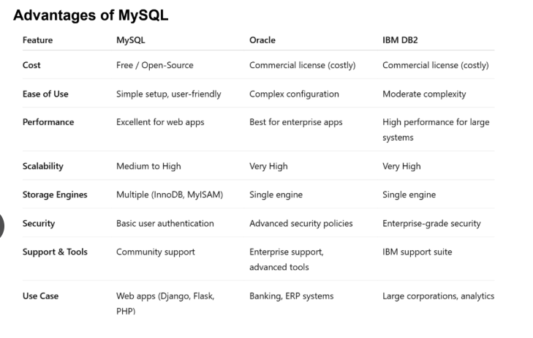
Advantages & Drawbacks of MySQL (Compared to Oracle & DB2)

Slide 21
Drawbacks:
Limited support for advanced enterprise features (like distributed transactions and parallel query execution).
Weaker data warehousing support compared to Oracle/DB2.
Less scalable for extremely large enterprise databases.
Some features (like stored procedures and triggers) are less powerful than Oracle’s PL/SQL.
Best Use Case: MySQL is ideal for web applications, startups, educational projects, and small–medium enterprises.
Oracle/DB2: Better suited for large-scale corporate, financial, and high-transaction systems.

Slide 22
Client-Server Architecture
Client: Application or user interface (e.g., Web App)
Server: MySQL engine storing & managing data
Flow: Client sends SQL → Server processes → Returns result

Slide 23
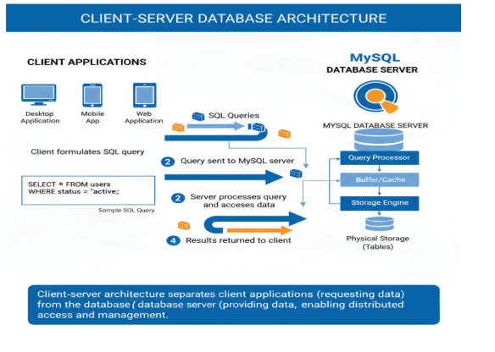

Slide 24
SQL Overview
History of SQL
SQL (Structured Query Language) was developed in the 1970s by IBM researchers Donald D. Chamberlin and Raymond F. Boyce.
It was initially called SEQUEL (Structured English Query Language).
Adopted by the American National Standards Institute (ANSI) in 1986 and the International Organization for Standardization (ISO) in 1987.
SQL became the standard language for relational database management systems (RDBMS).

Slide 25
Contd.,
Features of SQL
High-level language: SQL allows users to query and manipulate data without knowing the underlying database implementation.
Non-procedural: Focuses on what to do, not how to do it.
Standardized: Follows ANSI/ISO standards for compatibility across RDBMS.
Powerful: Can handle complex queries, joins, transactions, and aggregations.
Secure: Supports access control using DCL commands (GRANT, REVOKE).
Multi-user: Allows concurrent access with ACID transaction support.

Slide 26
SQL Sub-languages
SQL Commands
DDL(Data Definition Language)
DML(Data Manipulation Language)
DCL(Data Control Language)
TCL(Transaction Control Language)
DQL(Data Query Language)

Slide 27
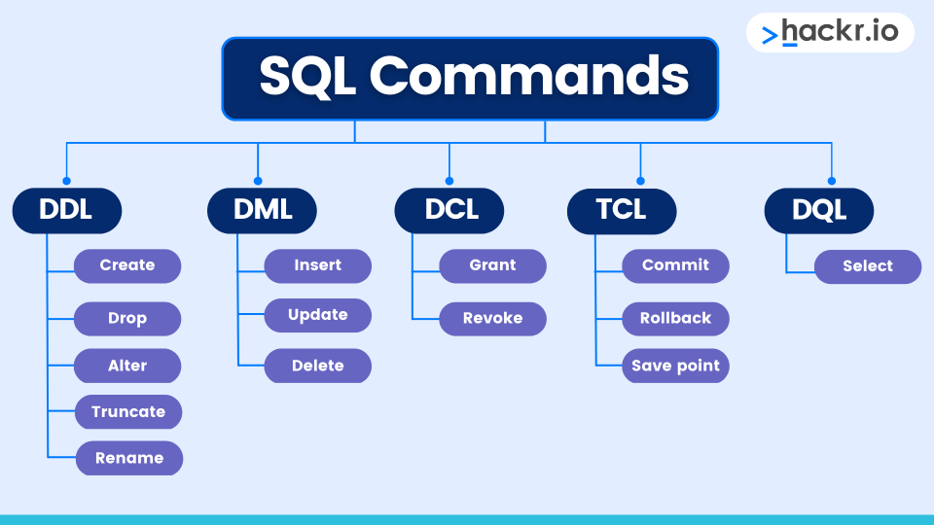
SQL Commands

Slide 28
Contd.,
Data Definition Language (DDL)
Purpose: Define or modify database structure (tables, schemas, indexes).
Effect: DDL commands change the structure of the database. Changes are auto-committed.
Data Manipulation Language (DML)
Purpose: Manage data inside database tables (insert, update, delete).
DML commands manipulate data but do not alter table structure. Changes can be committed or rolled back.

Slide 29
Contd.,
Data Query Language (DQL)
Purpose: Query and retrieve data from the database.
DQL is read-only; it does not modify data.
Data Control Language (DCL)
Purpose: Control access, permissions, and security.
DCL ensures security and controlled access in multi-user environments.
Transaction Control Language (TCL)
Purpose: Manage transactions to ensure data integrity.
TCL ensures ACID properties and maintains database consistency
during operations.

